Slide 1




NEXT GEN EMPLOYABILITY PROGRAM
Creating a future-ready workforce
Team Members
College Name
Student Name : NAVINA K.S
Student ID : 622021243039
PAAVAI COLLEGE OF ENGINEERING

Slide 2

CAPSTONE PROJECT SHOWCASE
Project Title
Building Bus Reservation System using Python and Django
Abstract | Problem Statement | Project Overview | Proposed Solution | Technology Used | Modelling & Results | Conclusion

Slide 3
Abstract
Online Bus Ticket Reservation System is a Web based application that works within a centralized network. This project presents a review on the software program "Online Bus Ticket Reservation System" as should be used in a bus transportation system, a facility which is used to reserve seats, cancellation of reservation and different types of route enquiries used on securing quick reservations. OBTRS is built for managing and computerizing the traditional database, ticket booking and tracking bus and travel made. It maintains all customer details, bus details, reservation details. In order to achieve the design, Imo Transport Company (ITC) was chosen as a case study because of its strategic importance to Imo State. Structured Systems Analysis and Design Methodology (SSADM) was adopted. In addition,Django language was used for the front-end of the software while the back end was designed using python The software achieved is capable of improving the customer hand and relationship management in ITC operations. It is recommended that despite the present functionality of the designed software, an additional functionality such as the use of E-mail to send tickets and notifications to the customer and an online payment using credit cards/debit cards should be implemented into the system. Furthermore, other operations carried by ITC such as the courier services should also be integrated in order to enhance the system.
Source :

Slide 4
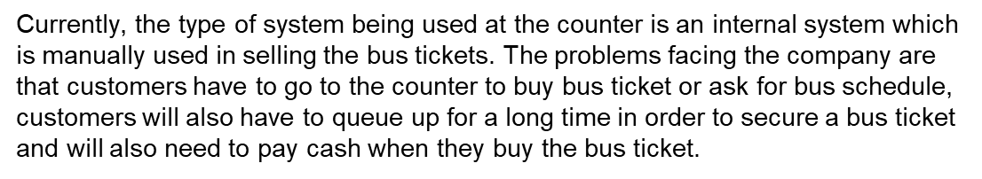
Problem Statement
Source :

Slide 5
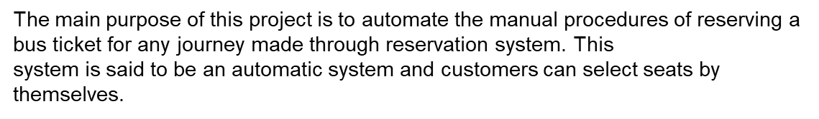
Project Overview
Source :

Slide 6
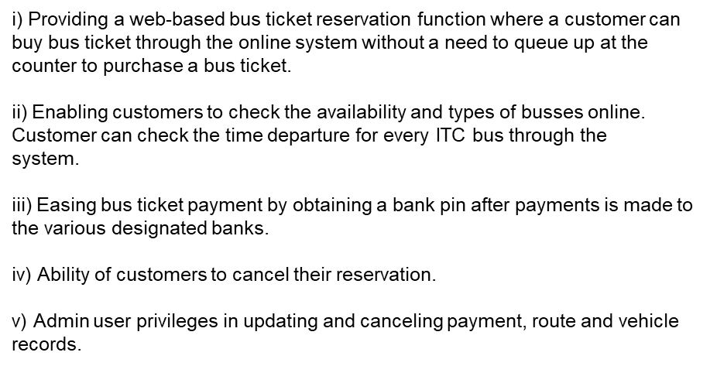
Proposed Solution
.
Source :

Slide 7


Technology Used
Front-end
Back-end
Source :

Slide 8
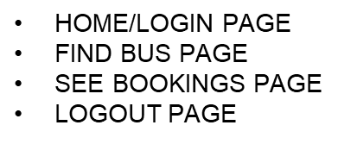

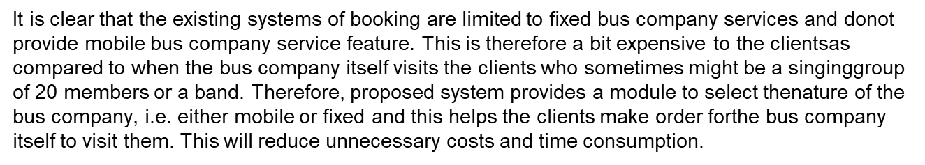
Modelling
Source :

Slide 9
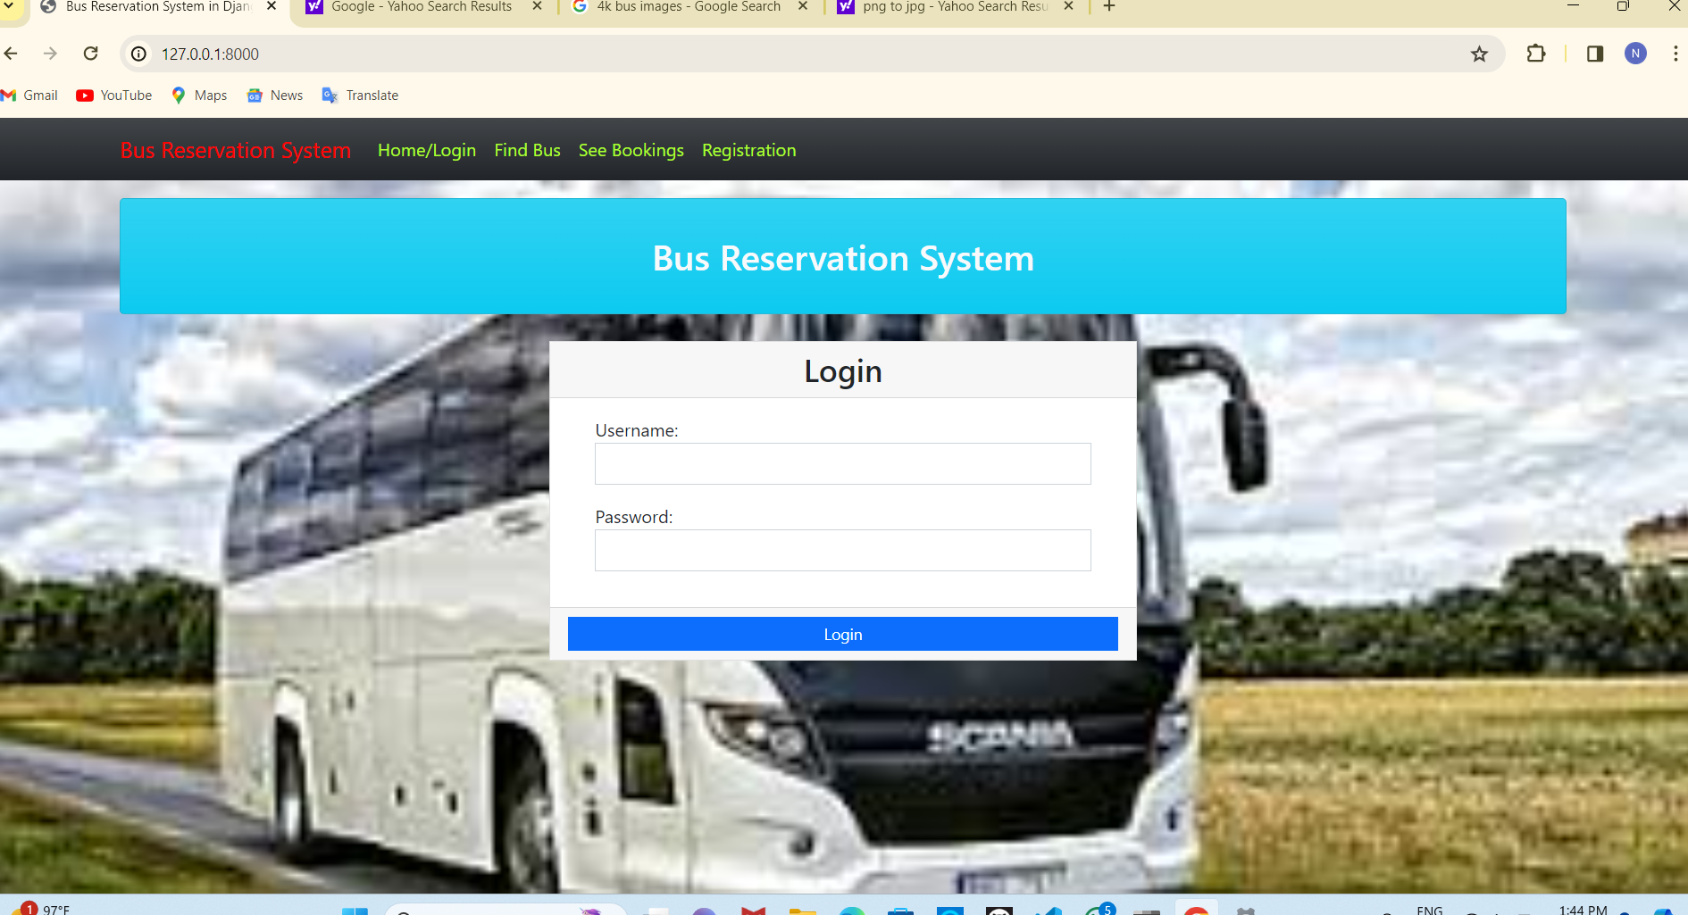
Homepage

Slide 10
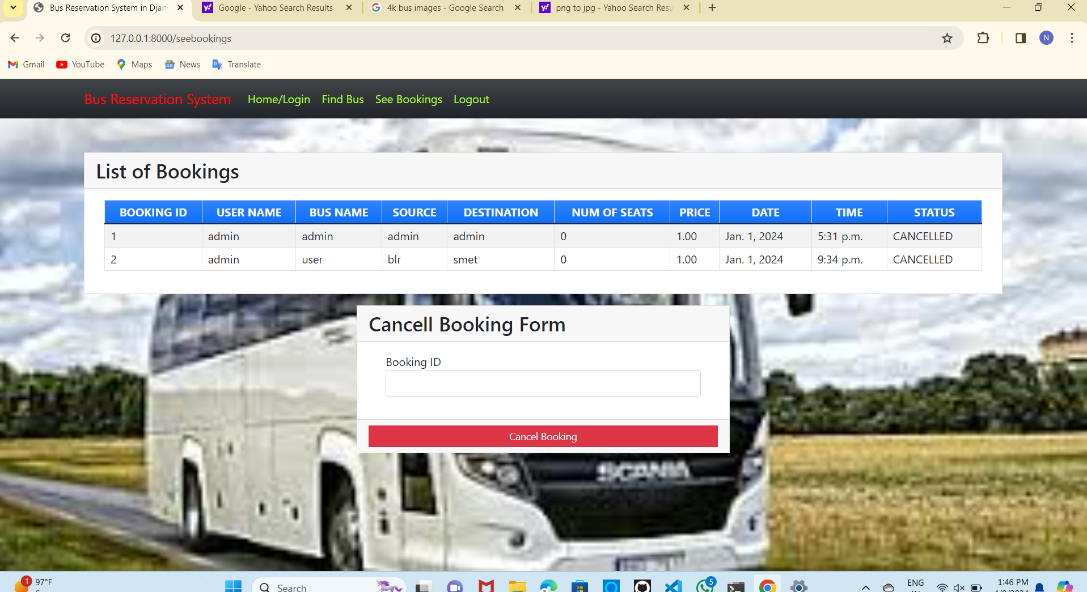
Service Page

Slide 11
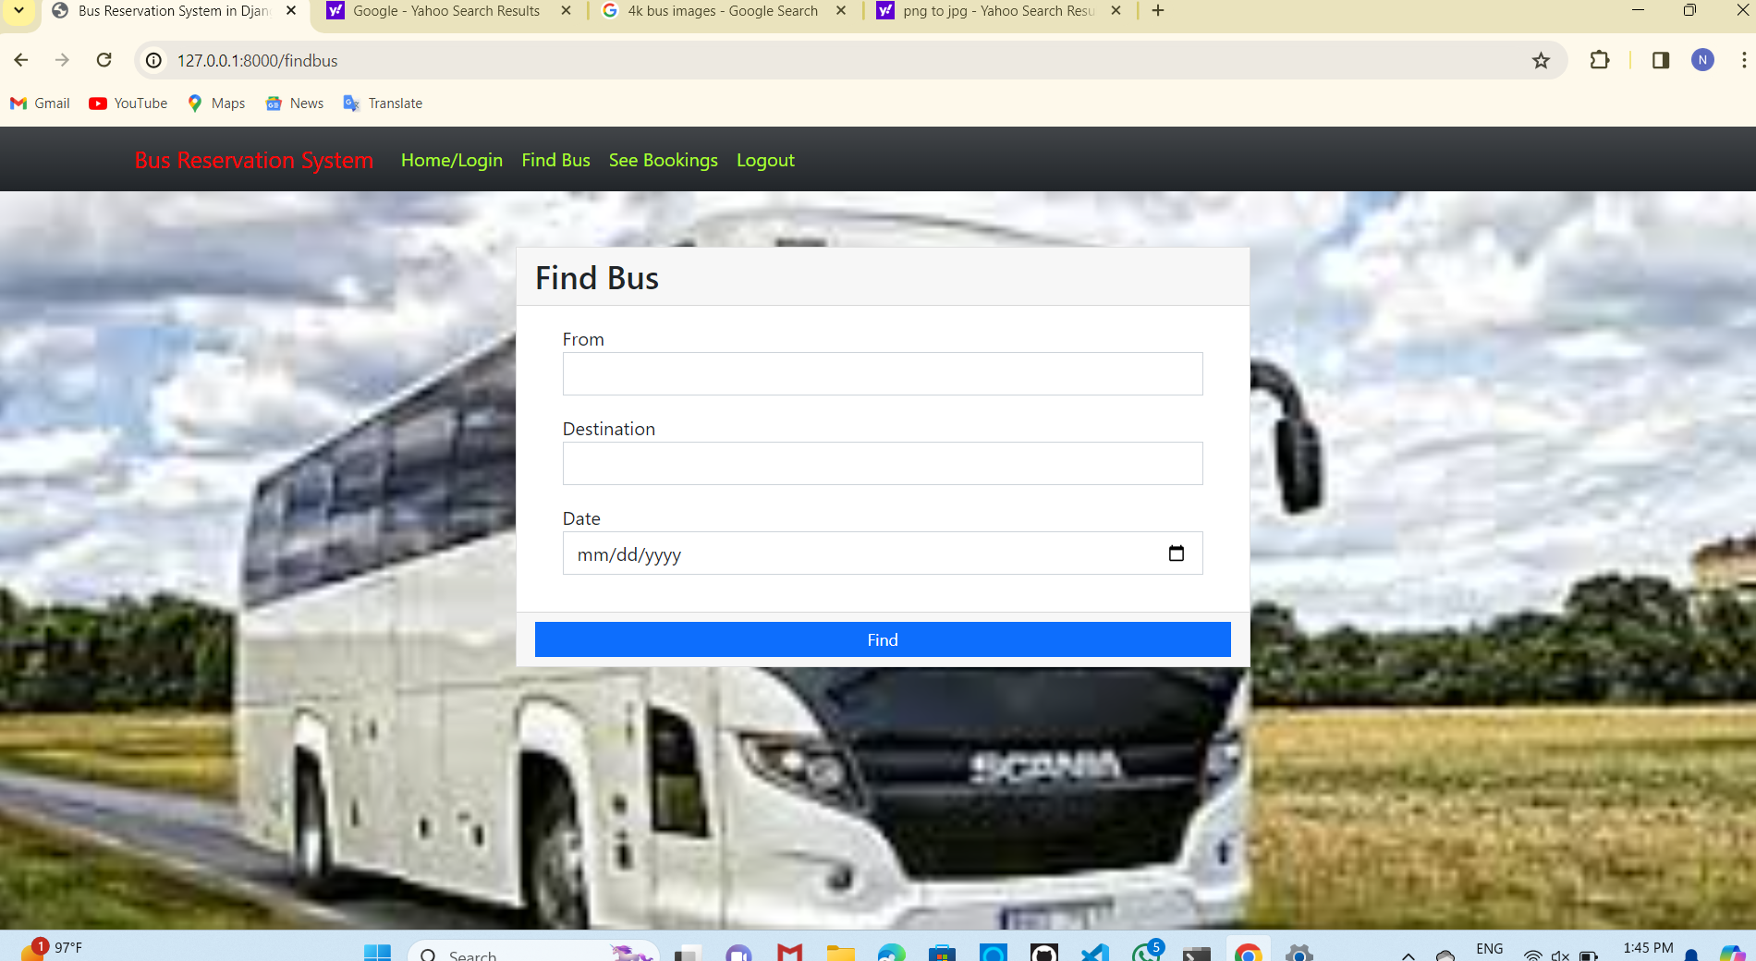
Departments-Page

Slide 12
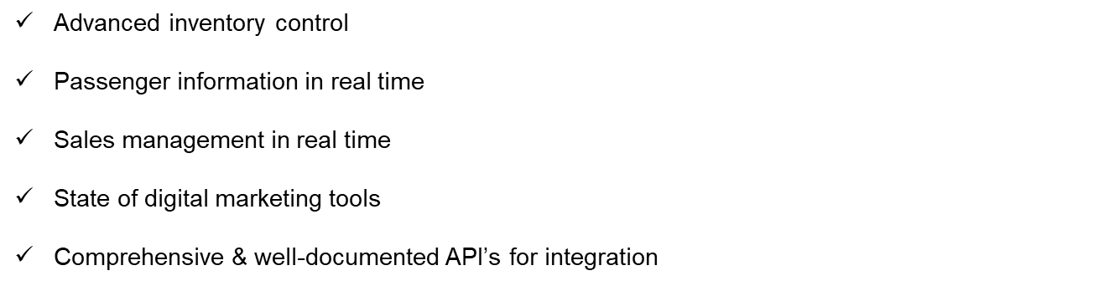
Future Enhancements:

Slide 13
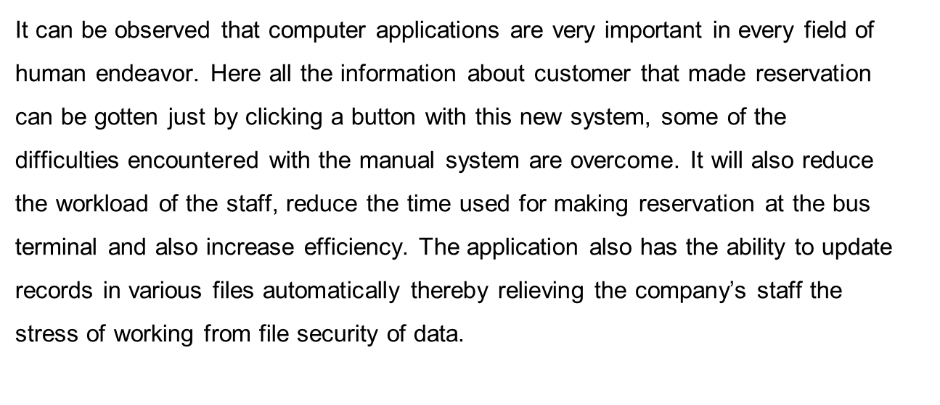
Conclusion
Source :

Slide 14
Thank You!
Notes:
Thank You !!

